Slide 1
Statistical Analysis of Text: Topic Modeling
Yevgeniy Golovchenko
PhD fellow
University of Copenhagen

Slide 2
Background
Visiting scholar at Waseda University
PhD Fellow at Department of Polticial Science (UCPH)
MA in Sociology
Research topics:
Digital disinformation
Political participation on social media
Russian and Ukrainian politics
Computational Social Science:
Social Network Analysis
NLP

Slide 3
Goals for today:
A broader understanding of supervised and unsupervised models
The logic of topic models in social science
Applying Structural Topic Modeling in R

Slide 4
Quantiative content analysis: Why?
Breadth
Variation over time
Causal hypothesis testing

Slide 5
What are topic models (LDA)
Developed by: David Blei, Andrew Ng, and Michael I. Jordan
A way of categorising text into topics
Topic: distribution over a vocabulary
Document: Distribution over topics
Mixed-membership model
Topic models vs counting words
TM captures the relational meaning of words

Slide 6
LDA:
A model of language
“Bag of words”
Documents are vectors (their length equal to the number of words)
Inferring the structure of language through probabilistic measures
Global distribution of topics across documents
Multinomial distribution of words over topics
The probability of words occurring in the respective topic
Notes:
the model optimizes joint frequencies and exclusivity

Slide 7
LDA:
Number of topics (K) is determined by the researcher
Topic prevalence (θ𝑑): The proportion of words in a document associated with the topic
Topical content: Frequently occurring words in a topic
Assumption: documents are generated independently from each other

Slide 8
STM
Developed by: Margaret E. Roberts, Brandon M. Stewart and Dustin Tingley
Based on LDA
Does not assume that documents are generated independently form each other
Includes covariates in the inference process
Correlation between:
Topics
Topic prevalence and covariates
Topical content and covariates

Slide 9
Two Examples of topic modelling
Literature
Religious discourse

Slide 10
Jockers, M.L. and Mimno, D., 2013. Significant themes in 19th-century literature
Analysis of literary works from 19th century
U.S. and Great Britain
LDA
Literary topics and gender
N = 3279

Slide 11
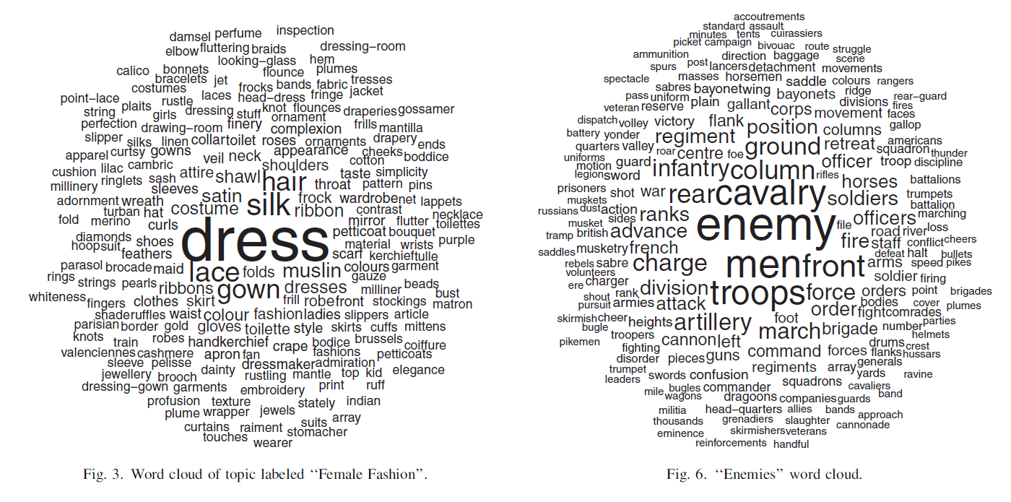
Gender an 19th Century literature
Source: Jockers, M.L. and Mimno, D., 2013. Significant themes in 19th-century literature. Poetics, 41(6)
Notes:
3279 literary works from U.S. and Great Brittain
Mathew L Jockers

Slide 12
Source: Lucas et al. (2015) Computer-assisted text analysis for comparative politics.
STM
11,045 texts religious texts from 33 clerics (20 jihadists, 13 non-jihadists”)
Is there a correlation between the source and topics?

Slide 13
Arabic Cleric writings
Source: Lucas et al. (2015) Computer-assisted text analysis for comparative politics. Political Analysis, 23(2)
Notes:
11,045 texts religious texts from 33 clerics (20 jihadists, 13 non-jihadists”

Slide 14
Supervised Models vs Unsupervised models
SVM, Naive Bayes etc.
Manual labelling (test set + training set)
Easy to interpret
Non-explorative
LDA, STM etc.
Semi-automatic approach
Difficult to interpret
Explorative

Slide 15
STM in three steps
Processing
Generating model
Interpreting

Slide 16
Your turn!
Download the script at:
golovchenko.github.io/stm.R
Dataset used in the Example:
Facebook posts written by Donald Trump and Hillary Clinton on their pages during 2016
Collected using Facebook app called “Netvizz”
For details see:
Rieder, B., 2013, May. Studying Facebook via data extraction: the Netvizz application. In Proceedings of the 5th annual ACM web science conference (pp. 346-355). ACM.

Slide 17
Processing
Stemming
Walk, walks, walked, walking, walker, walkers
walk, walk, walk, walk, walker, walker
Removing stop words (and, or, if, at etc.)
Lowercase
Removing numbers, URL’s etc.

Slide 18
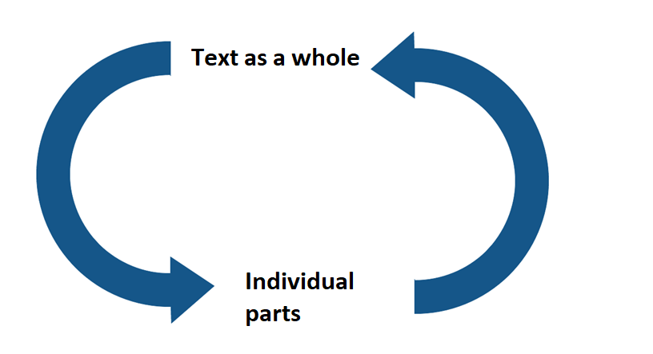
Interpreting: Hermeneutic circle

Slide 19
Gender an 19th century literature
Source: Jockers, M.L. and Mimno, D., 2013. Significant themes in 19th-century literature. Poetics, 41(6)
Notes:
3279 literary works from U.S. and Great Brittain
Mathew L Jockers

Slide 20
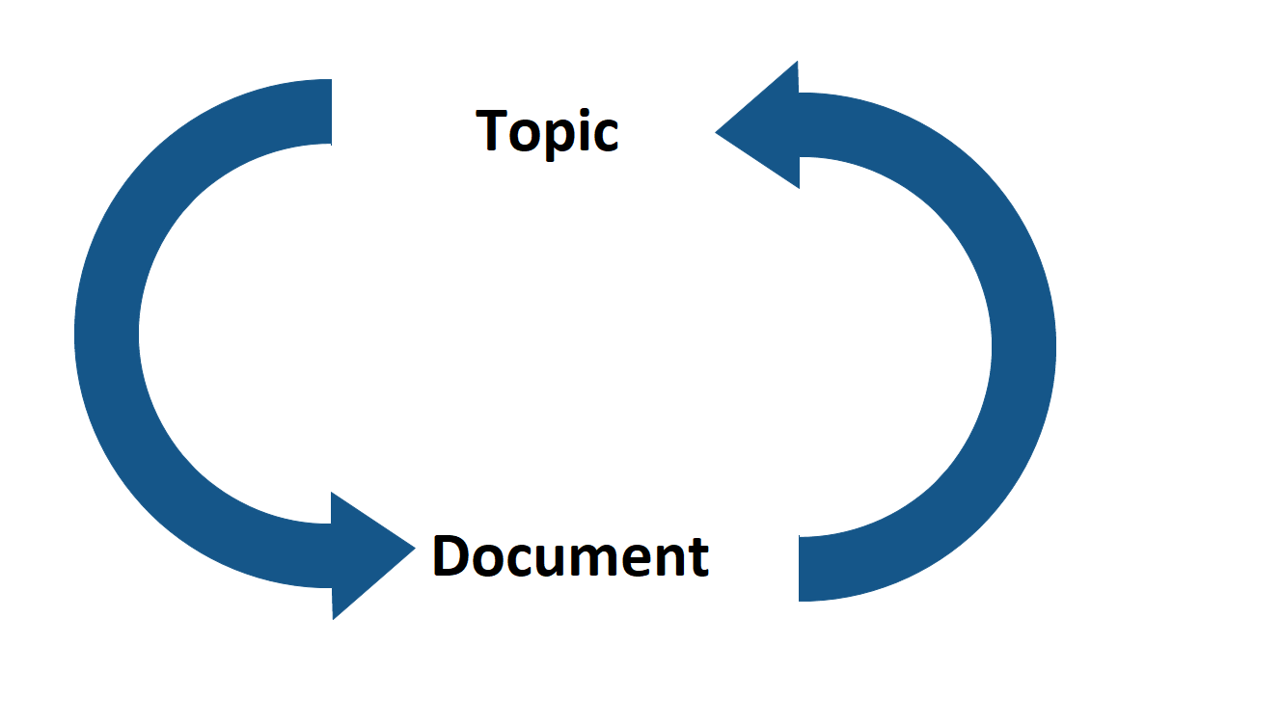
Interpreting: Hermeneutic circle

Slide 21
Visualizing topics
Explore the corpus of Facebook posts in the interactive graph generated by using the package stmBrowser:
http://golovchenko.github.io/k10/viz.html

Slide 22
Contact
yg@ifs.ku.dk

